Slide 1
ARTIFICIAL INTELLIGENCE

Slide 2
UNIT 3
Knowledge Representation Issues

Slide 3
Representations and Mappings
In order to solve complex problems encountered in artificial intelligence, one needs both a large amount of knowledge and some mechanism for manipulating that knowledge to create solutions.
Knowledge and Representation are two distinct entities. They play central but distinguishable roles in intelligent system.
Knowledge is a description of the world. It determines a system's competence by what it knows.
Representation is the way knowledge is encoded. It defines a system's performance in doing something.
Different types of knowledge require different kinds of representation.
The Knowledge Representation models/mechanisms are often based on:
Logic
Rules
Frames
Semantic Net

Slide 4
Knowledge is categorized into two major types:
Tacit corresponds to "informal" or "implicit“
Exists within a human being;
It is embodied.
Difficult to articulate formally.
Difficult to communicate or share.
Hard to steal or copy.
Drawn from experience, action, subjective insight
Explicit formal type of knowledge, Explicit
Explicit knowledge
Exists outside a human being;
It is embedded.
Can be articulated formally.
Can be shared, copied, processed and stored.
Easy to steal or copy
Drawn from artifact of some type as principle, procedure, process, concepts.

Slide 5
A variety of ways of representing knowledge have been exploited in AI programs.
There are two different kinds of entities, we are dealing with.
Facts: Truth in some relevant world. Things we want to represent.
Representation of facts in some chosen formalism. Things we will actually be able to manipulate.
These entities are structured at two levels:
The knowledge level, at which facts are described.
The symbol level, at which representation of objects are defined in terms of symbols that can be manipulated by programs

Slide 6
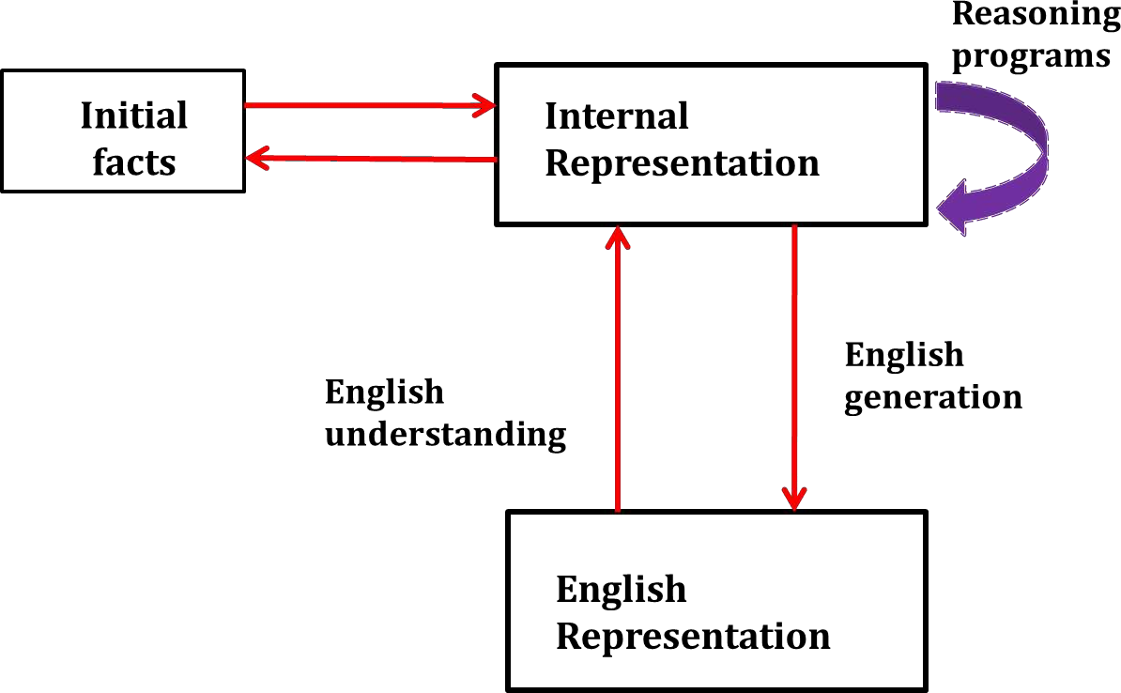
Mapping between Facts and Representations

Slide 7
Framework of Knowledge Representation
Computer requires a well-defined problem description to process and provide well-defined acceptable solution.
To collect fragments of knowledge we need first to formulate a description in our spoken language and then represent it in formal language so that computer can understand.
The computer can then use an algorithm to compute an answer. This process is illustrated as,

Slide 8
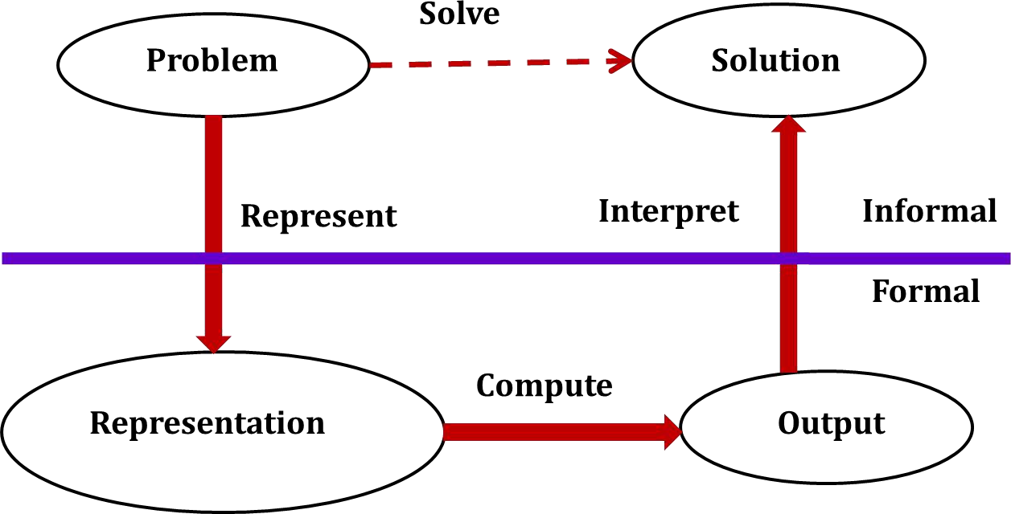
Knowledge Representation Framework

Slide 9
The steps are:
The informal formalism of the problem takes place first.
It is then represented formally and the computer produces an output.
This output can then be represented in an informally described solution that user understands or checks for consistency.
The Problem solving requires,
Formal knowledge representation, and
Conversion of informal knowledge to formal knowledge that is conversion of implicit knowledge to explicit knowledge.

Slide 10
Mapping between Facts and Representation
Knowledge is a collection of facts from some domain.
We need a representation of "facts“ that can be manipulated by a program.
Normal English is insufficient, too hard currently for a computer program to draw inferences in natural languages.
Thus some symbolic representation is necessary.

Slide 11
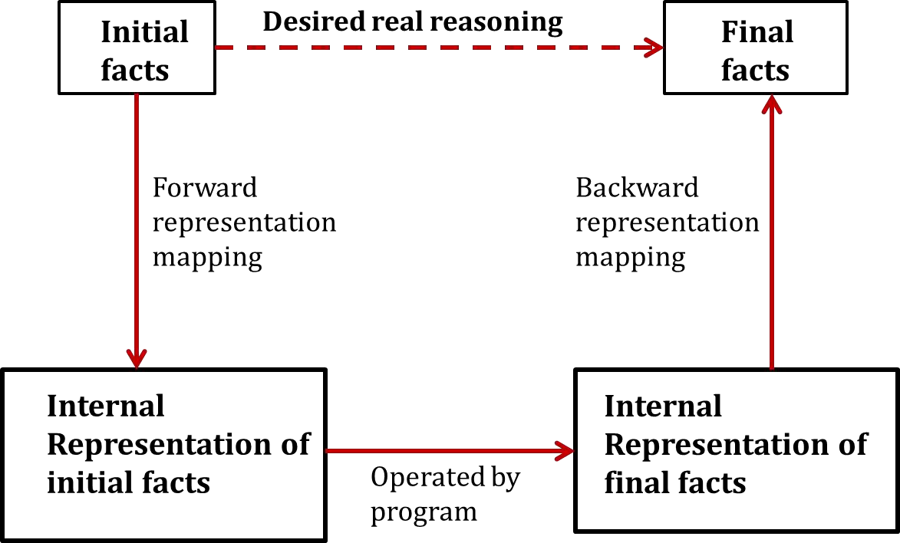
Representation of Facts

Slide 12
Approaches to knowledge Representation
A good knowledge representation enables fast and accurate access to knowledge and understanding of the content.
A knowledge representation system should have following properties.
Representational Adequacy
The ability to represent all kinds of knowledge that are needed in that domain.
Inferential Adequacy
The ability to manipulate the representational structures to derive new structures corresponding to new knowledge inferred from old.
Inferential Efficiency
The ability to incorporate additional information into the knowledge structure that can be used to focus the attention of the inference mechanisms in the most promising direction.
Acquisitional Efficiency
The ability to acquire new knowledge using automatic methods wherever possible rather than reliance on human intervention.

Slide 13
Knowledge Representation Schemes
Relational Knowledge :
The simplest way to represent declarative facts is as a set of relations of the same sort used in the database system.
Provides a framework to compare two objects based on equivalent attributes.
Any instance in which two different objects are compared is a relational type of knowledge.
The table below shows a simple way to store facts.
The facts about a set of objects are put systematically in columns.
This representation provides little opportunity for inference.
Given the facts it is not possible to answer simple question such as :

Slide 14
“Who is the heaviest player?”
But if a procedure for finding heaviest player is provided, then these facts will enable that procedure to compute an answer.
We can ask things like who "bats – left" and "throws – right".
Player | Height | Weight | Bats - Throws
Aaron | 6-0 | 180 | Right - Right
Mays | 5-10 | 170 | Right - Right
Ruth | 6-2 | 215 | Left - Left
Williams | 6-3 | 205 | Left - Right

Slide 15
Inheritable Knowledge
Here the knowledge elements inherit attributes from their parents.
The knowledge is embodied in the design hierarchies found in the functional, physical and process domains.
Within the hierarchy, elements inherit attributes from their parents, but in many cases not all attributes of the parent elements be prescribed to the child elements.
The inheritance is a powerful form of inference, but not adequate.
The basic KR (Knowledge Representation) needs to be augmented with inference mechanism.
Property inheritance: The objects or elements of specific classes inherit attributes and values from more general classes.
The classes are organized in a generalized hierarchy.

Slide 16
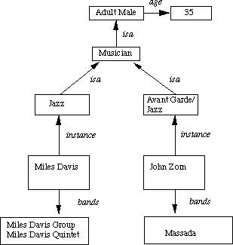
Boxed nodes -- objects and values of attributes of objects.
Arrows -- point from object to its value.
This structure is known as a slot and filler structure, semantic network or a collection of frames.

Slide 17
The steps to retrieve a value for an attribute of an instance object:
Find the object in the knowledge base
If there is a value for the attribute report it
Otherwise look for a value of an instance, if none fail
Otherwise go to that node and find a value for the attribute and then report it
Otherwise search through using is a until a value is found for the attribute.

Slide 18
Inferential Knowledge
This knowledge generates new information from the given information.
This new information does not require further data gathering form source, but does require analysis of the given information to generate new knowledge.
Example: given a set of relations and values, one may infer other values or relations. A predicate logic (a mathematical deduction) is used to infer from a set of attributes. Inference through predicate logic uses a set of logical operations to relate individual data.
Represent knowledge as formal logic:
All dogs have tails ∀x: dog(x) → hastail(x)
Advantages:
A set of strict rules.
Can be used to derive more facts.
Truths of new statements can be verified.
Guaranteed correctness.
Many inference procedures available to implement standard rules of logic popular in AI systems. e.g Automated theorem proving.

Slide 19
Procedural Knowledge
A representation in which the control information, to use the knowledge, is embedded in the knowledge itself. For example, computer programs, directions, and recipes; these indicate specific use or implementation;
Knowledge is encoded in some procedures, small programs that know how to do specific things, how to proceed.

Slide 20
Advantages:
Heuristic or domain specific knowledge can be represented.
Extended logical inferences, such as default reasoning facilitated.
Side effects of actions may be modeled. Some rules may become false in time. Keeping track of this in large systems may be tricky.
Disadvantages:
Completeness -- not all cases may be represented.
Consistency -- not all deductions may be correct. e.g If we know that Fred is a bird we might deduce that Fred can fly. Later we might discover that Fred is an emu.
Modularity is sacrificed. Changes in knowledge base might have far-reaching effects.
Cumbersome control information.

Slide 21
Issues in Knowledge Representation
The fundamental goal of Knowledge Representation is to facilitate inference (conclusions) from knowledge.
The issues that arise while using KR techniques are many. Some of these are explained below.

Slide 22
Important Attributes :
Any attribute of objects so basic that they occur in almost every problem domain?
There are two attributes "instance" and "isa", that are of general significance. These attributes are important because they support property inheritance.
Relationship among attributes:
Any important relationship that exists among object attributes?
The attributes we use to describe objects are themselves entities that we represent.
The relationship between the attributes of an object, independent of specific knowledge they encode, may hold properties like:

Slide 23
Inverses - This is about consistency check, while a value is added to one attribute. The entities are related to each other in many different ways.
Existence in an isa hierarchy - This is about generalization-specialization, like, classes of objects and specialized subsets of those classes, there are attributes and specialization of attributes. For example, the attribute height is a specialization of general attribute physical-size which is, in turn, a specialization of physical-attribute. These generalization-specialization relationships are important for attributes because they support inheritance.
Techniques for reasoning about values - This is about reasoning values of attributes not given explicitly. Several kinds of information are used in reasoning, like,

Slide 24
height : must be in a unit of length,
Age: of person cannot be greater than the age of person's parents.
The values are often specified when a knowledge base is created.
Single valued attributes - This is about a specific attribute that is guaranteed to take a unique value. For example, a baseball player can at time have only a single height and be a member of only one team. KR systems take different approaches to provide support for single valued attributes.

Slide 25
Choosing Granularity :
At what level of detail should the knowledge be represented?
Regardless of the KR formalism, it is necessary to know :
At what level should the knowledge be represented and what are the primitives?"
Should there be a small number or should there be a large number of low-level primitives or High-level facts.
High-level facts may not be adequate for inference while Low-level primitives may require a lot of storage.
Example of Granularity :
Suppose we are interested in following facts: John spotted Sue.

Slide 26
This could be represented as
Spotted (agent(John), object (Sue))
Such a representation would make it easy to answer questions such are :
Who spotted Sue? Suppose we want to know :
Did John see Sue?
Given only one fact, we cannot discover that answer.
We can add other facts, such as
Spotted (x , y) → saw (x , y)
We can now infer the answer to the question.

Slide 27
Set of objects :
How should sets of objects be represented?
There are certain properties of objects that are true as member of a set but not as individual;
Example : Consider the assertion made in the sentences : "there are more sheep than people in Australia", and "English speakers can be found all over the world."
To describe these facts, the only way is to attach assertion to the sets representing people, sheep, and English.
The reason to represent sets of objects is: If a property is true for all or most elements of a set, then it is more efficient to associate it once with the set rather than to associate it explicitly with every elements of the set .
This is done,
in logical representation through the use of universal quantifier, and
in hierarchical structure where node represent sets and inheritance propagate set level assertion down to individual.

Slide 28
Finding Right structure :
Given a large amount of knowledge stored in a database, how can relevant parts are accessed when they are needed?
This is about access to right structure for describing a particular situation.
This requires, selecting an initial structure and then revising the choice.
While doing so, it is necessary to solve following problems :
how to perform an initial selection of the most appropriate structure.
how to fill in appropriate details from the current situations.
how to find a better structure if the one chosen initially turns out not to be appropriate.
what to do if none of the available structures is appropriate.
when to create and remember a new structure.
There is no good, general purpose method for solving all these problems. Some knowledge representation techniques solve some of these issues.

